Slide 1


Database Design Fundamentals Solving Problems Before they Start!
Edward Pollack
Microsoft Data Platform MVP

Slide 2
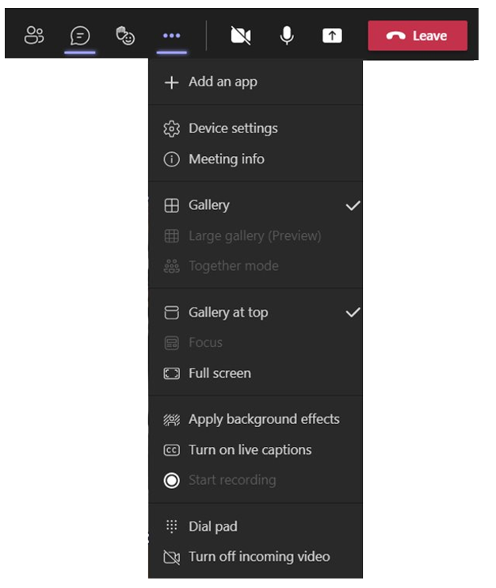
Microsoft Teams Refresher
5
4
6
1
Can’t hear? Check your Device settings
Privacy issues? Click Apply background effects to blur your background
Trouble hearing still? Turn on Live Captions
Use the Raise hand feature to get your speaker’s attention
Ask in chat to be invited to speak or share!
Unless invited to show, keep video off because video can be distracting
2
3

Slide 3
Agenda
Why does database design matter to us?
What is needed to make good decisions?
Examples of database design best practices
Decisions & considerations when creating data structures
Conclusion/Questions?

Slide 4
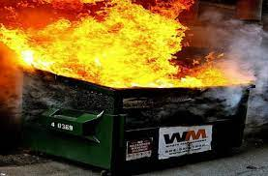
Why Database Design Matters?
Align business needs → Implementation
Better Performance
Scalability
Ease of documentation
Decrease maintenance costs (aka: technical debt)
Avoid this:

Slide 5
Business/Application Logic
What is the business need?
This may be 100% non-technical in nature!
What is the database used for?
How is it accessed & Who uses it?
What is the future of this data?
Data structures cannot be effectively built without understanding their purpose

Slide 6

Choose the Right Solution!
Choose ideal data structures for different data sets. For example:
Transactional data (where ACID matters): SQL Server – rowstore
Transactional data (where ACID doesn’t matter): Cosmos DB (a noSQL solution)
Data Warehouse: Azure Synapse, SQL Server columnstore (structured OLAP storage)
Analytic data (no clear structure): Azure data lake storage
Text search/parsing: Elastic Search, Azure Cognitive Search (optimized for text)
3rd party services
Consider on-premises vs. cloud. Each has advantages/disadvantages.
This decision is easy to make and hard to unmake!

Slide 7

Scalability
Design for today, tomorrow, and the future…YEARS from now!
Hardware, software, licensing needs.
Database size (row count, footprint)
Consider contention and concurrency
High availability and disaster recovery: What is your RTO and RPO?
Re-evaluate scalability as the app grows and evolves over time

Slide 8
Designing Tables
One table = one distinct entity
One column = one distinct data element
Choose a single table type per entity:
Entity
Lookup
Relationship
Schemas can classify tables into name spaces, security groups, etc…
Tables should have a clustered index. Exceptions to this are rare.
Unique/increasing/narrow. Or columnstore, if working with OLAP data.
Clustered index will usually match the primary key (or a critical alternate key).

Slide 9
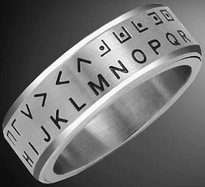
Data Types
Choose a natural data type
Choose the ideal data length, precision, and size.
Unsure what to do? Use a standard!
ISO5218 for gender, ISO4217 for currency, ISO3166 for country, etc…
Bit = 0 or 1. Do not use TINYINT, SMALLINT, INT, VARCHAR, etc…
When deciding on decimal/numeric data types, consider which mathematical operations will be performed on the data.
Do not encode data into unnatural data types.
Sure, bitmaps are cool, but they are hard to read and understand without a secret decoder ring.

Slide 10

Dates & Times
Be consistent across all tables!
Do (or will) time zones matter? If so, use:
DATETIMEOFFSET
UTC
Store in correctly-sized/scoped data type:
Times = TIME
Dates = DATE
Datetimes = DATETIME2, DATETIMEOFFSET, etc…
Avoid strings, integers, or decimals for dates/times.
Differentiate between a date/time and duration
Durations have units like SECOND, MILLISECOND, or MINUTE
Configure your database server in UTC time or a time zone with no daylight savings.

Slide 11
NULL
NULL = Does Not Exist. It is NOT A VALUE!
Do not make up “De-nullifiers” unless they have true meaning!
-1, ‘1/1/1900’, ‘N/A’, ‘’, ‘00:00:00’…
NOT NULL =
Required by the application
Always has a meaningful value
NULL
Decide what it means
SET ANSI NULLS ON (beware NULL behavior)
Normalization can remove NULL if it is problematic

Slide 12
Naming Objects
What is it? Do not name for location, time, usage, etc…
Column names should be unique and used consistently across all tables.
BIT columns should describe what is being tested, for example:
Is_deleted, is_administrator, has_seventeen_pizzas, is_active, etc…
Avoid abbreviations/shorthand. Do not fear longer object names!
AccountOwner is far better than AcctOwr
Avoid spaces, special characters, etc…They break things!
Object names should be as self-explanatory as possible.

Slide 13
OLAP vs. OLTP
Transactional data is very different from analytic data!
Transactional data: Few rows, more columns, lots of updates/inserts/deletes
Analytic data: Many rows, fewer columns, mostly inserts
Separate reporting/analytics from transactional (application) processing.
Different tools may be needed for each.
Running OLAP on OLTP or OLTP on OLAP data structures will be expensive!

Slide 14
Data Integrity
If it matters, then use:
Foreign keys
Check constraints
Default constraints
Validation processes
Data integrity also improves performance

Slide 15
Old Data
Is old data deleted, inactivated, partitioned, archived, etc…?
Is archiving allowed, desired, or required?
How is data associated with archived data managed?
Have a data retention policy
Compliance needs
Contractual obligations
Helps keep data size manageable
When building a new data structure, ask what its retention is.
Can old data be stored elsewhere?
Is keeping it for posterity good enough?

Slide 16
Conclusion
Good database design saves time, effort, and money!
Creates data structures that are easier to understand and use.
Poor design = technical debt!
Simple is better, when possible.
Future you will thank current you for making more thoughtful decisions now!

Slide 17
Edward Pollack
Find me here:
ed@edwardpollack.com
Ed Pollack | LinkedIn
Ed Pollack (@EdwardPollack) / Twitter
Find my content here:
EdwardPollack (Ed Pollack) (github.com)
Edward Pollack, Author at Simple Talk (red-gate.com)
Ed Pollack, Author at SQL Shack - articles about database auditing, server performance, data recovery, and more

